Slide 1

House Price Market Statistical Analysis
Yohann Bertrand

Slide 2
Dataset : House Property Sales Time Series
This report introduces an analysis based on the dataset titled: House Property Sales Time Series (kaggle.com) found on Kaggle.
The dataset provides a comprehensive record of property sales for a specific region over a period of 12 years, from 2007 to 2019.
The primary focus of this analysis will be on the statistical aspects of the data, providing insights into the trends and patterns in property sales over the given period.

Slide 3
Table of Contents: Data Analysis Breakdown
Initial Analysis → understanding our data
Regression Analysis → discerning a trend
Hypothesis Testing (A/B testing) → Do house and units are the same
Risk Estimation (CVaR) → prediction of investments returns

Slide 4
Dataset format : the columns
datesold: This represents the date when the property was sold.
The data is in datetime format.
postcode: This is the postal code of the property that was sold.
This data is in the int64 format.
price: This refers to the selling price of the property.
This data is in the int64 format.
propertyType: This variable indicates the type of property sold, whether it was a house or a unit. This data is in the String format.
bedrooms: This represents the number of bedrooms in the sold property. This data is in the int64 format.

Slide 5
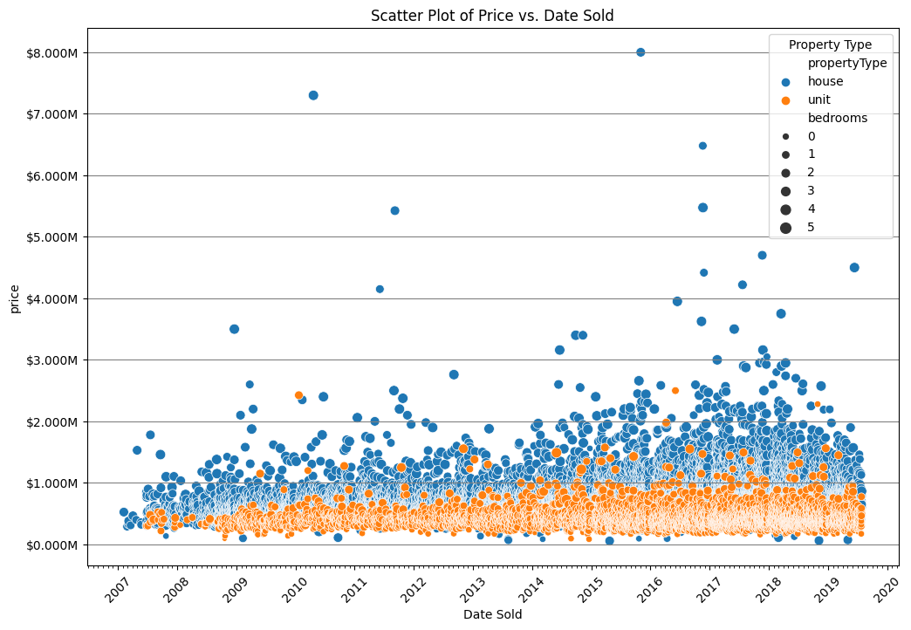
Dataset distribution
Orange dot represents units
Blue represents houses.
Units are typically less expensive, and their selling prices seems more tightly distributed.

Slide 6
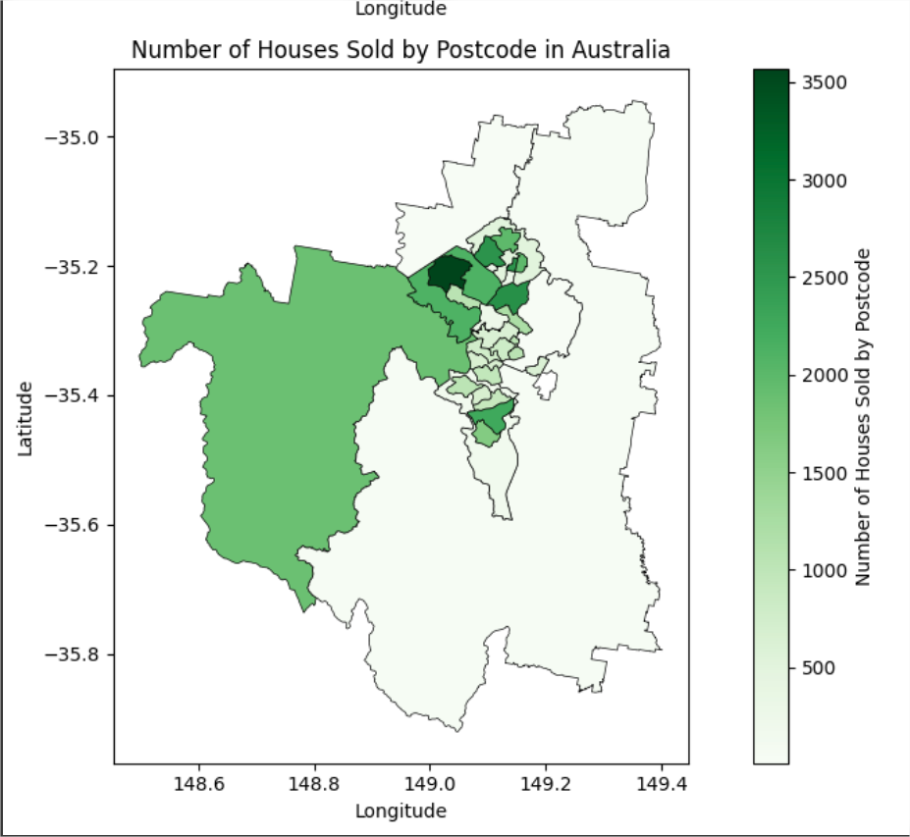
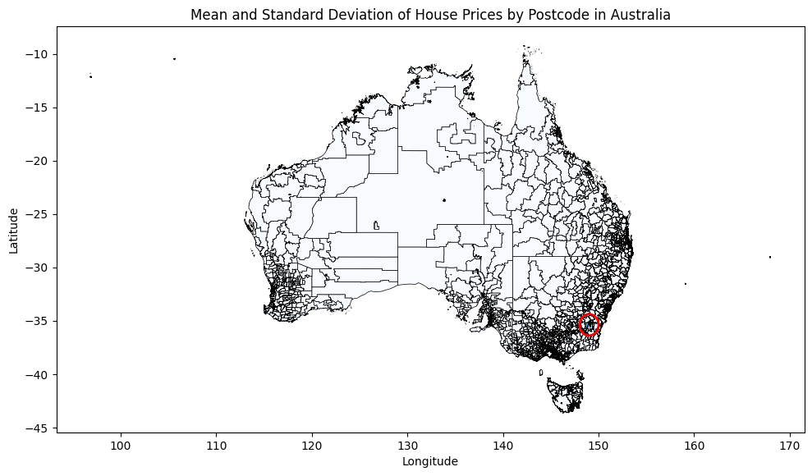
Location of the Data
The data, characterized by shrinking postcode regions, is centered around a city, identified as Canberra on a map.
The quantity of houses sold is less informative due to potential concentration of a firm’s activities in certain regions.

Slide 7
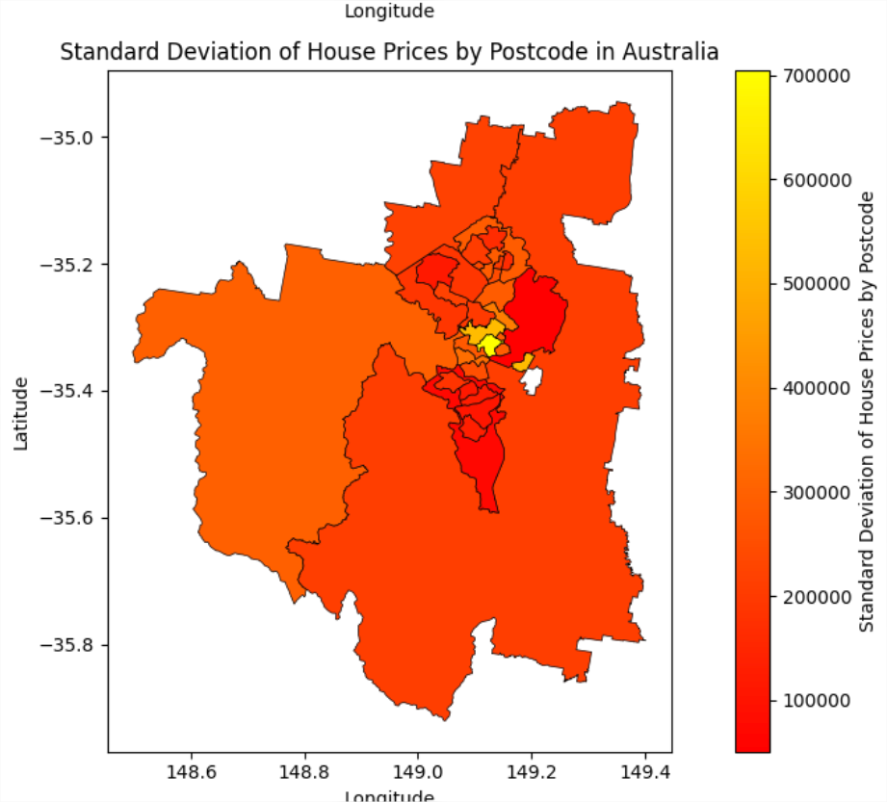
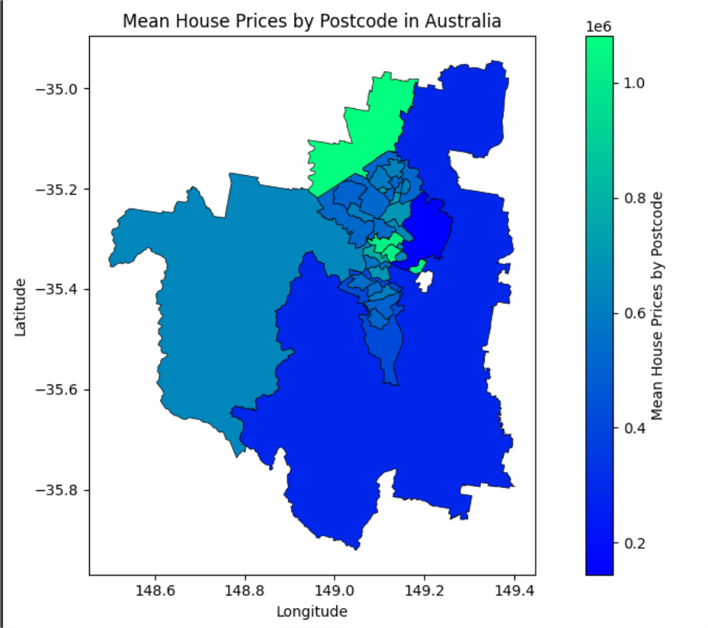
In the heart of the city, where neighborhoods vary from rich to poor, house prices show a wide range. This is based on a small sample of about 1k sales which could explain this phenomenon.
The average house price is notably high in the city core and surprisingly, also in the upper north region. This rural area has fewer sales, but the properties sold probably come with larger plots of land, contributing to the high average price.

Slide 8
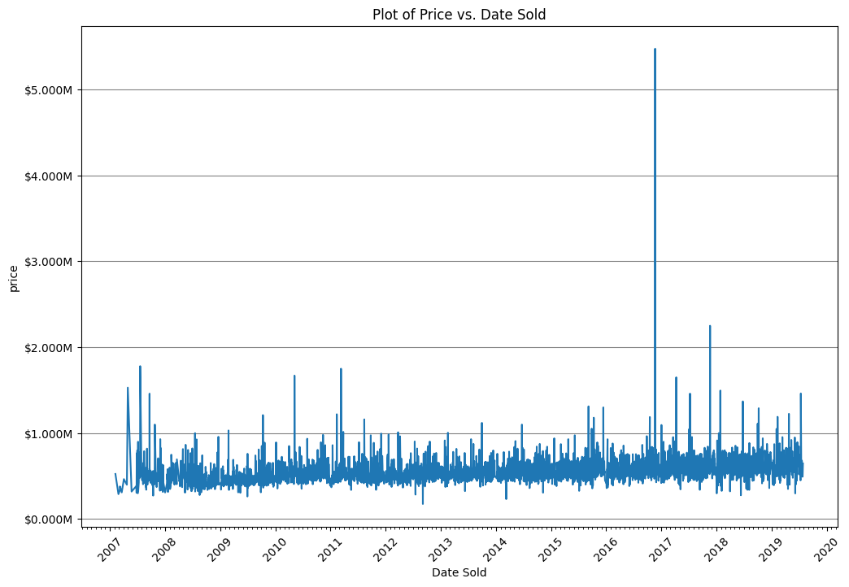
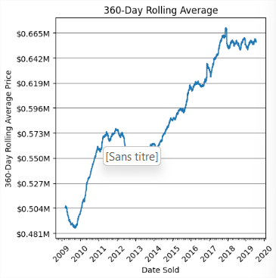
Median sold price for each day
360 day rolling average of sold price
Small increase in the price difference beginning in 2015, and one also from 2010 to 2012.

Slide 9
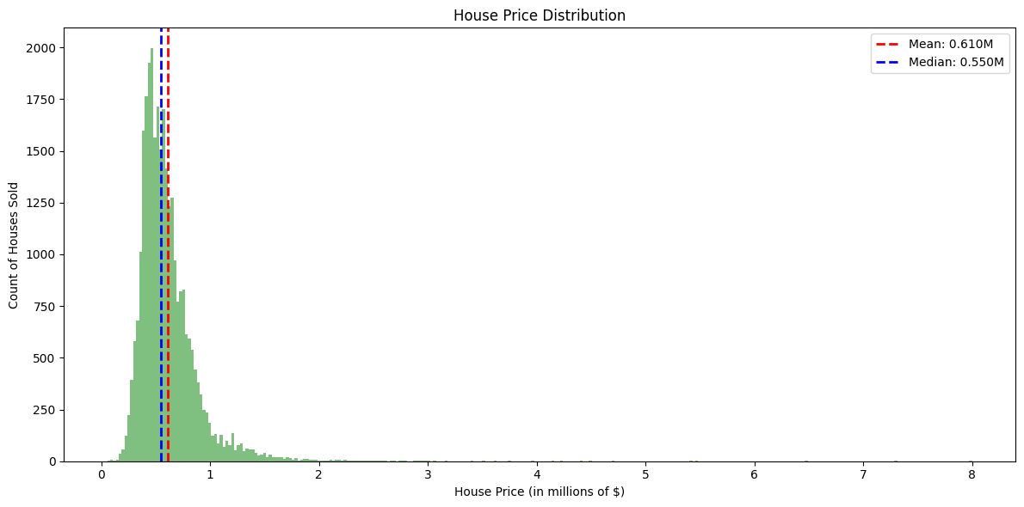
Data Skewing
the data is heavily skewed to the right since there’s a value at 6 million and the mean is at 600k, while the median is at 550k.

Slide 10
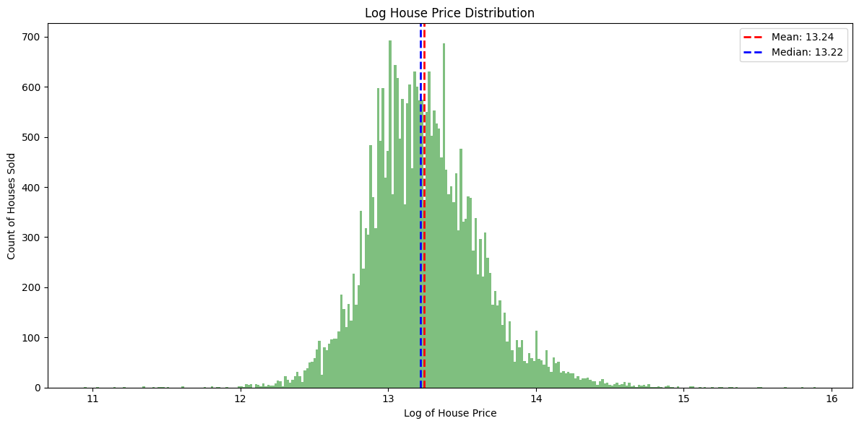
Logged price to reduce skewness
Now, the data is less skewed and, while not totally uniformly distributed, it’s better than the non-logged price.

Slide 11
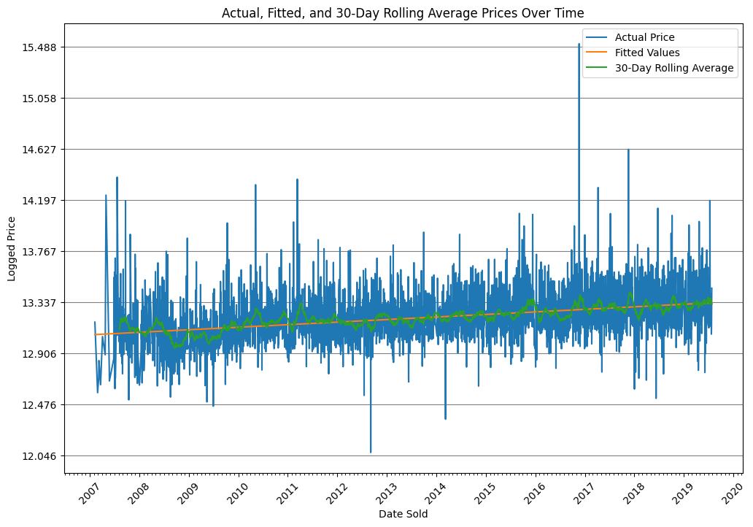
OLS linear regression
R² = 0.117
11.7 % of the variability can be explained by the linear regression
The Durbin-Watson statistic is 1.959, which is close to 2. This suggests that there is no significant autocorrelation in the residuals.

Slide 12
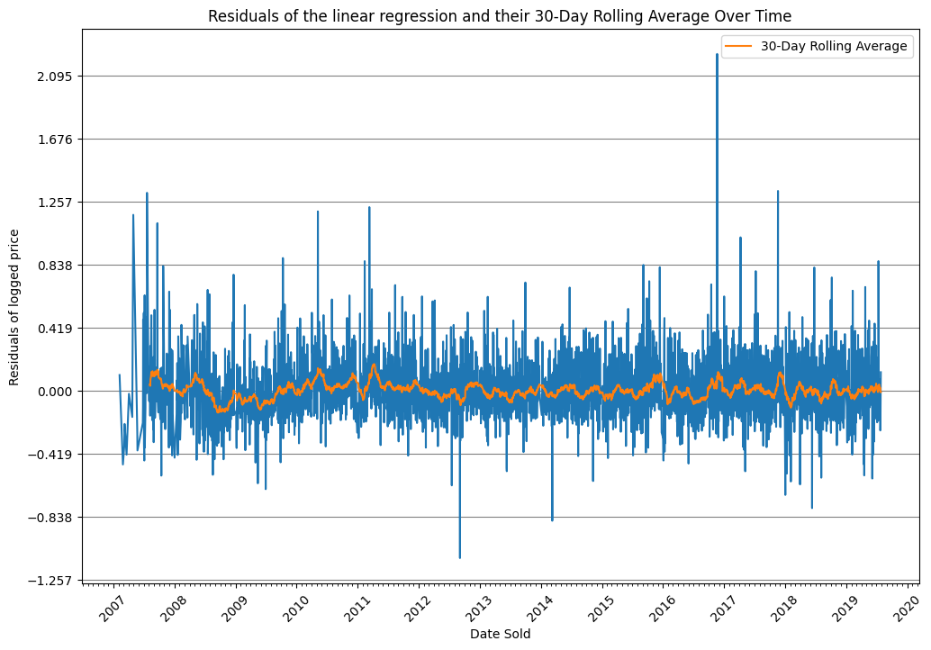
Residuals of the linear regression
In the plot of the residuals of the model, we can observe a small lump shortly after mid-2008 that is probably linked to the financial crisis.
However, the rest of the plot seems to fluctuate around 0. This suggests that our model is doing a decent job of capturing the general trend, but there may be specific events or factors that are not accounted for in the model.

Slide 13
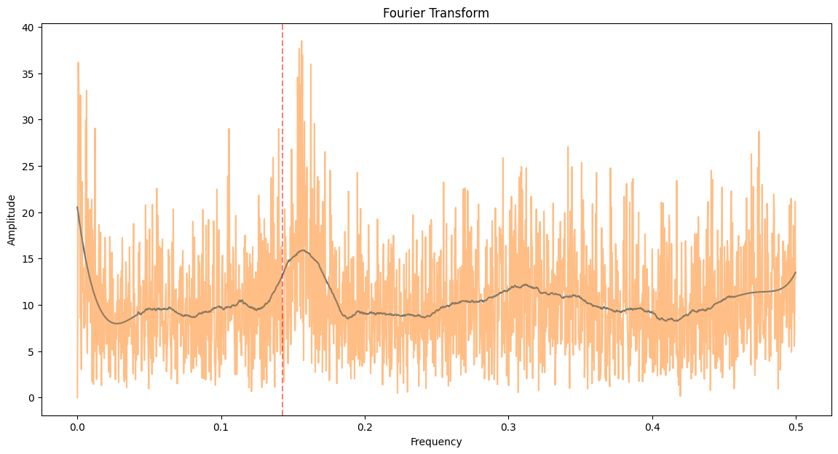
Residuals of the linear regression
A Fourier transform of the residuals data to see if there's any periodic fluctuation that we can observe.
To better see the data trend, we apply a Savitzky-Golay filter.
We can observe a bump around 6.4 days of period (the red line represent a 7-day period). we think that it could be related to a weekly cycle, but it’s curious that it isn't centered around 7 days.

Slide 14
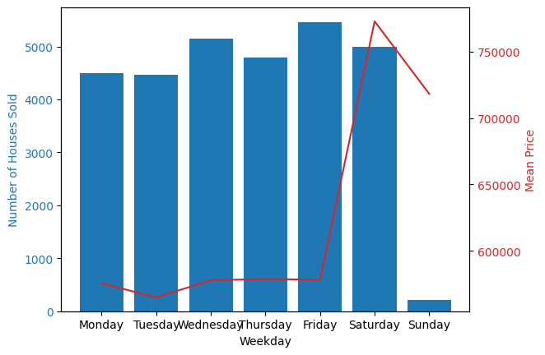
Weekly Cycle
The number of houses sold is fairly equal for each weekday, except for Sunday when there are significantly fewer sales. This could be linked to company schedules, such as having a day off each Sunday, or other factors.
Interestingly, more expensive houses tend to be sold on the weekend, particularly on Saturday. The sales on Sunday could potentially be leftovers from Saturday. This could be explained by the fact that people with higher incomes may work during the week and therefore can’t buy or sell houses, or perhaps sellers wait until the weekend to showcase their pricier houses.
This analysis provides insight into why the Fourier transform showed a “weekly” cycle. It’s clear that the day of the week has a significant impact on house sales. This kind of cyclical pattern is common in many types of time series data and understanding it can be very useful for predicting future trends.

Slide 15
Are Houses and units statistically different?
We runed a T-test to test the null hypothesis
The p-value obtained from the test is 0.
Which means there’s virtually no chance that the null hypothesis is true.
In other words, we can confidently say that there’s a statistically significant
difference between units and houses.

Slide 16
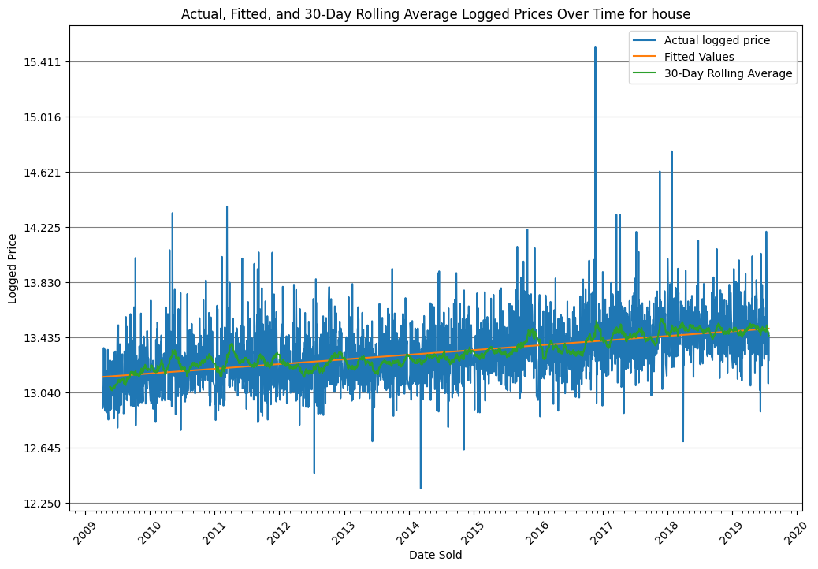
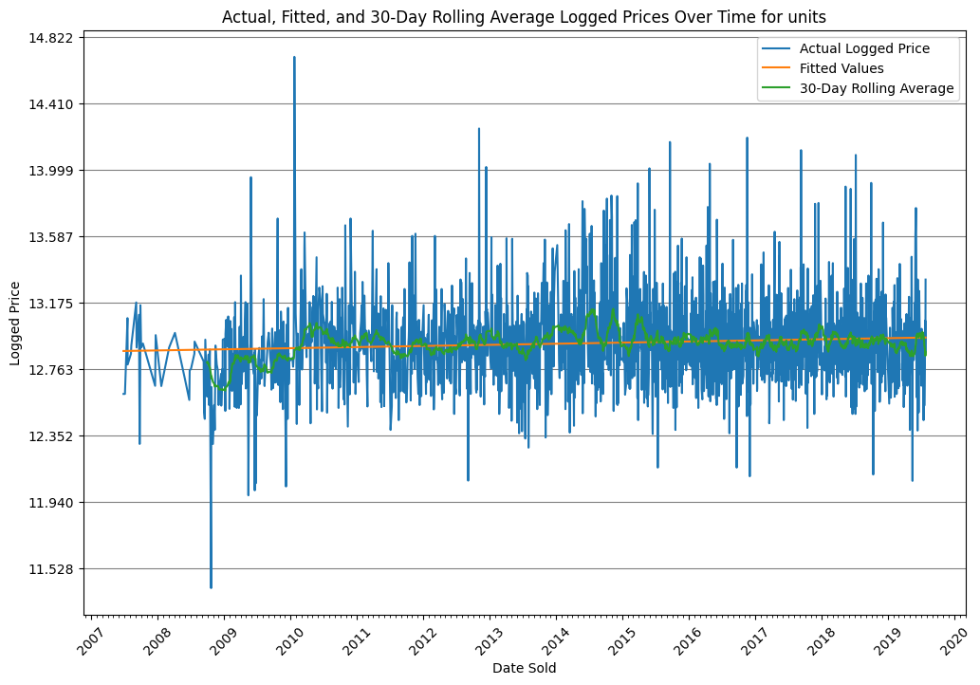
OLS linear regression for houses and units
For house : R² = 0.241
For units : R² = 0.007
Our analysis reveals a distinct difference in the price change over time between houses and units.
We hypothesize that this could be due to the increasing value of land over time.
However, without concrete data to support this hypothesis, we are unable to definitively prove it. Further research and data collection would be necessary to validate this assumption.

Slide 17
Conditional Value at Risk
Based on the historical data from the past 12 years, the Conditional Value at Risk (CVaR) at the 95% confidence level is -36.74%. This means that, if we look at the worst 5% of investment outcomes in this period, the losses exceeded 36.74% of the investment value. However, in 95% of cases, the losses were less than 36.74%.
To put it another way, if you were to randomly pick a day in the past 12 years and make an investment in house prices, there’s a 95% chance that your investment would not lose more than 36.74% of its value based on the historical data.

Slide 18
In this table, we present the probability of selling a property at a certain percentage of its value after a specified number of years. Our findings indicate that patience can be beneficial when it comes to real estate investment. The longer you hold onto a property, the better your chances of at least recouping what you paid for the house and potentially making a profit. However, there remains a slight risk of incurring greater losses. This suggests that a long-term investment strategy could be advantageous in the housing market.
Years | Minimum percentage of return for selling a Property
 | 25 % | 50 % | 75 % | 100 % | 125 % | 150 % | 175 % | 200 %
1 | 99,97 % | 98.84 % | 88.72 % | 55.26 % | 22.88 % | 7.62 % | 2.74 % | 1.41 %
2 | 99.81 % | 96.55 % | 82.42 % | 57.14 % | 33.31 % | 18.47 % | 9.75 % | 5.23 %
5 | 98.82 % | 91.02 % | 77.20 % | 60.41 % | 46.24 % | 34.64 % | 25.70 % | 19.28 %
10 | 96.75 % | 87.06 % | 75.99 % | 64.56 % | 54.85 % | 46.58 % | 39.41 % | 33.98 %

Slide 19
In this table, we present the probability of selling a house at a certain percentage of its value after a specified number of years. The principle that underlies the table is consistent: the longer you wait, the better your chances of gaining more in return. However, the probabilities are even higher for houses. This can be explained by the fact that houses seem to have a higher rise in price over time, as observed in the A/B section of our analysis.
Years | Minimum percentage of return for selling a House
 | 25 % | 50 % | 75 % | 100 % | 125 % | 150 % | 175 % | 200 %
1 | 99,97 % | 98.92 % | 90.64 % | 56.75 % | 23.66 % | 7.48 % | 2.71 % | 1.15 %
2 | 99.82 % | 97.38 % | 84.86 % | 59.62 % | 35.45 % | 18.67 % | 9.85 % | 5.34 %
5 | 99.14 % | 92.87 % | 80.21 % | 64.24 % | 50.01 % | 37.69 % | 28.25 % | 20.89 %
10 | 97.70 % | 89.68 % | 79.53 % | 69.22 % | 59.50 % | 51.19 % | 44.19 % | 37.96 %

Slide 20
In this table, we present the probability of selling a unit at a certain percentage of its value after a specified number of years. The principle that underlies the table is consistent: the longer you wait, the better your chances of gaining more in return. However, the probabilities are lesser for units. This can be explained by the fact that units seem to don't really rise in price over time, as observed in the A/B section of our analysis.
Years | Minimum percentage of return for selling a unit
 | 25 % | 50 % | 75 % | 100 % | 125 % | 150 % | 175 % | 200 %
1 | 99,82 % | 96.69 % | 80.87 % | 50.95 % | 25.37 % | 12.70 % | 6.19 % | 3.94 %
2 | 99.27 % | 92.04 % | 73.76 % | 51.57 % | 34.08 % | 21.77 % | 14.23 % | 9.05 %
5 | 95.76 % | 82.50 % | 66.58 % | 52.92 % | 41.71 % | 33.15 % | 26.45 % | 21.17 %
10 | 89.90 % | 75.68 % | 63.53 % | 53.59 % | 46.22 % | 40.65 % | 34.99 % | 30.97 %

